Slide 1
RICH Control Manual
September 20, 2021

Slide 2
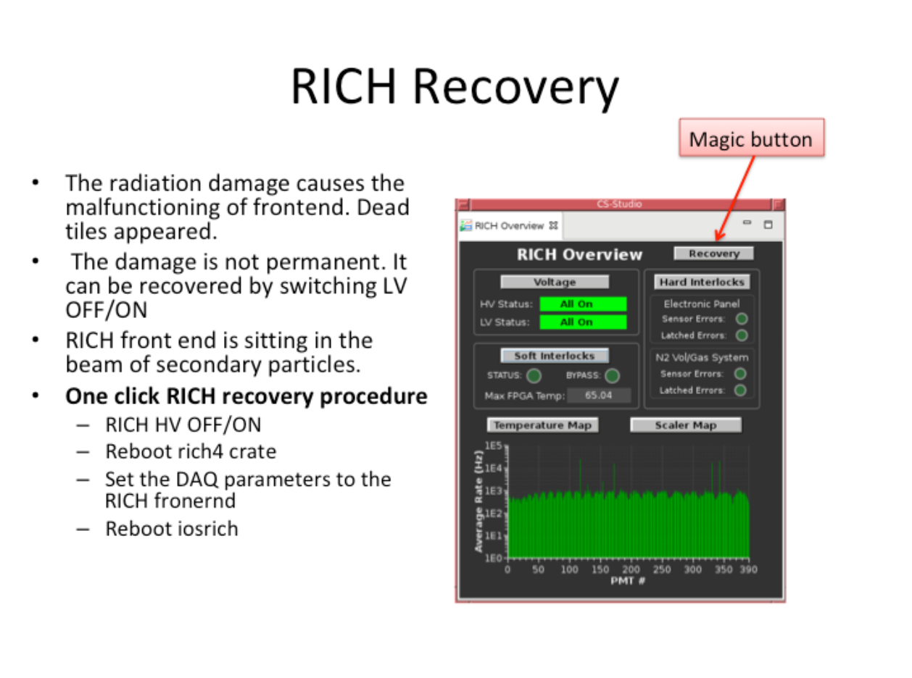
RICH Recovery
Do RICH RECOVERY every day shift and in case of missing tiles in the temperature or scaler plots
RICH Recovery has to be done EVERY day during day shift
In case several tiles are absent do RICH Recovery as well

Slide 3
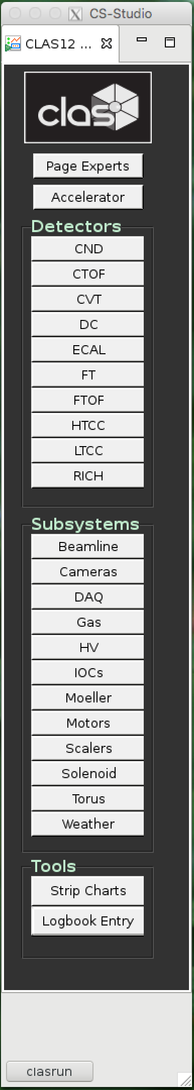
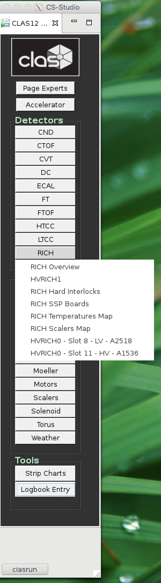
Press RICH on clascss menu
Chose RICH Overview

Slide 4
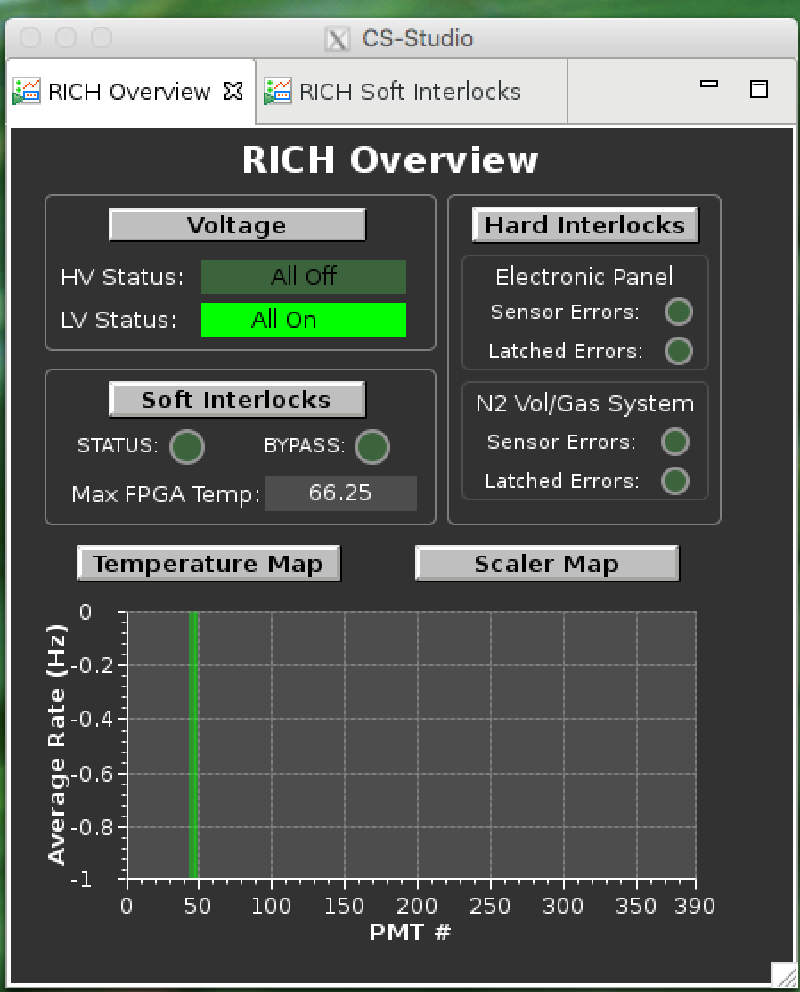
RICH Overview
Voltage control RICH HV and LV
Temperature Map
Shows the temperature of the RICH electronic boards
Scaler Map
Presents the rate of the MAPMT pixels
Hard Interlock
Control the RICH interlock
Soft Interlock
Control the max temperature of the RICH electroinics

Slide 5
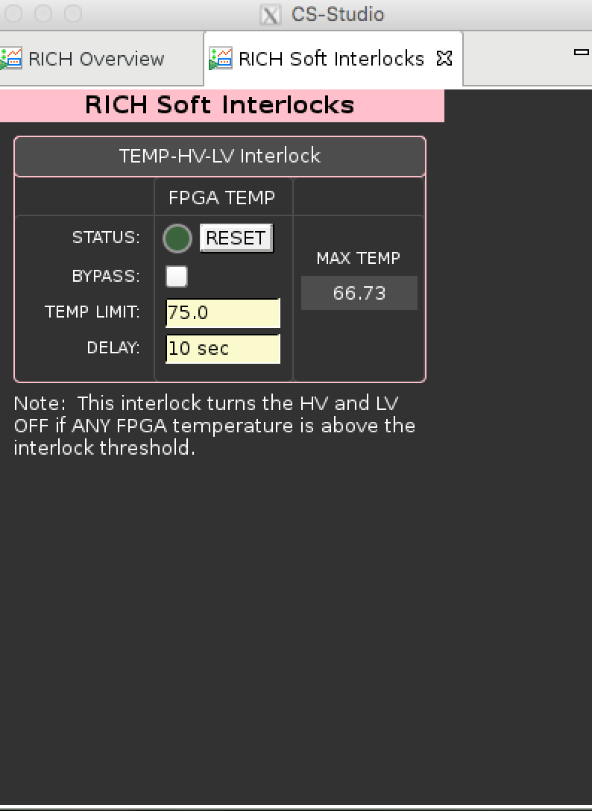
Soft Interlock
Max temperature has to be less than 75 C
Reset the interlock if necessary

Slide 6
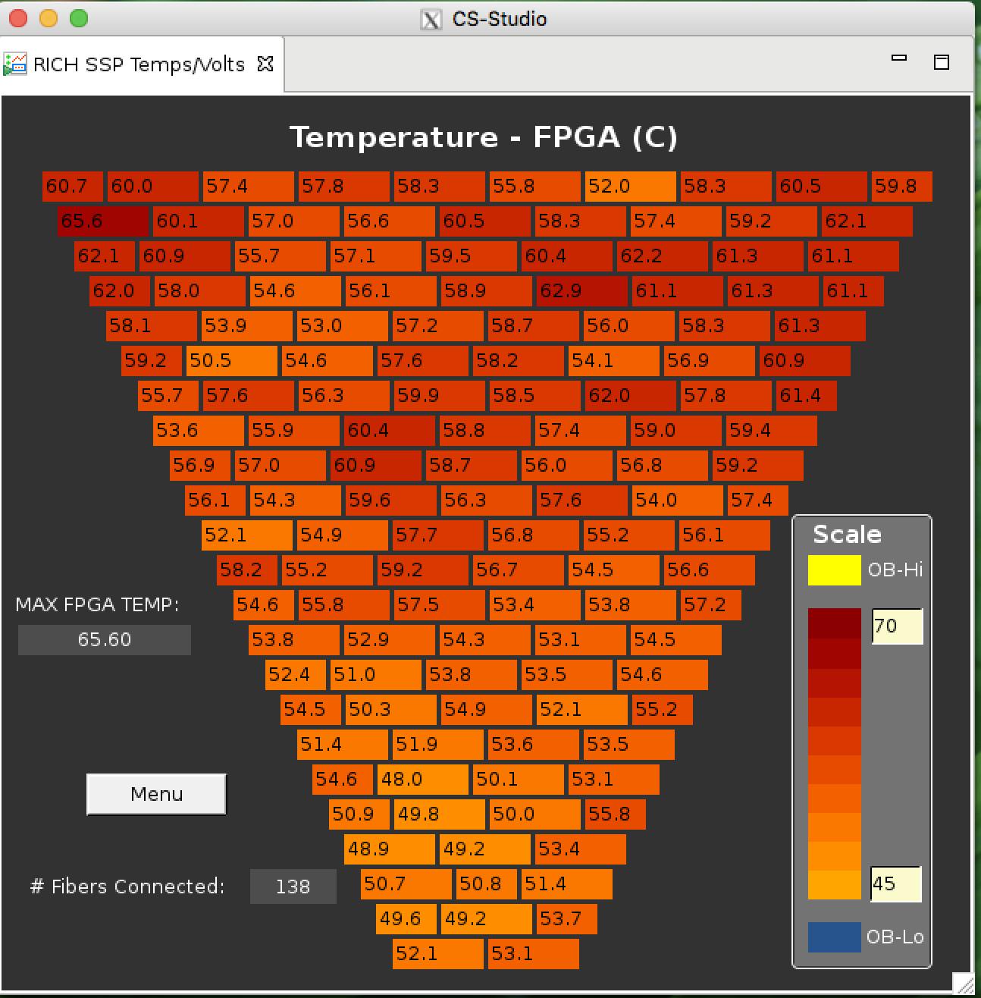
Temperature Map
Max temperature has
to be less than 75 C
Soft interlock switchs off
The RICH HV and LV if t>75C⁰
All tiles have to be present!

Slide 7
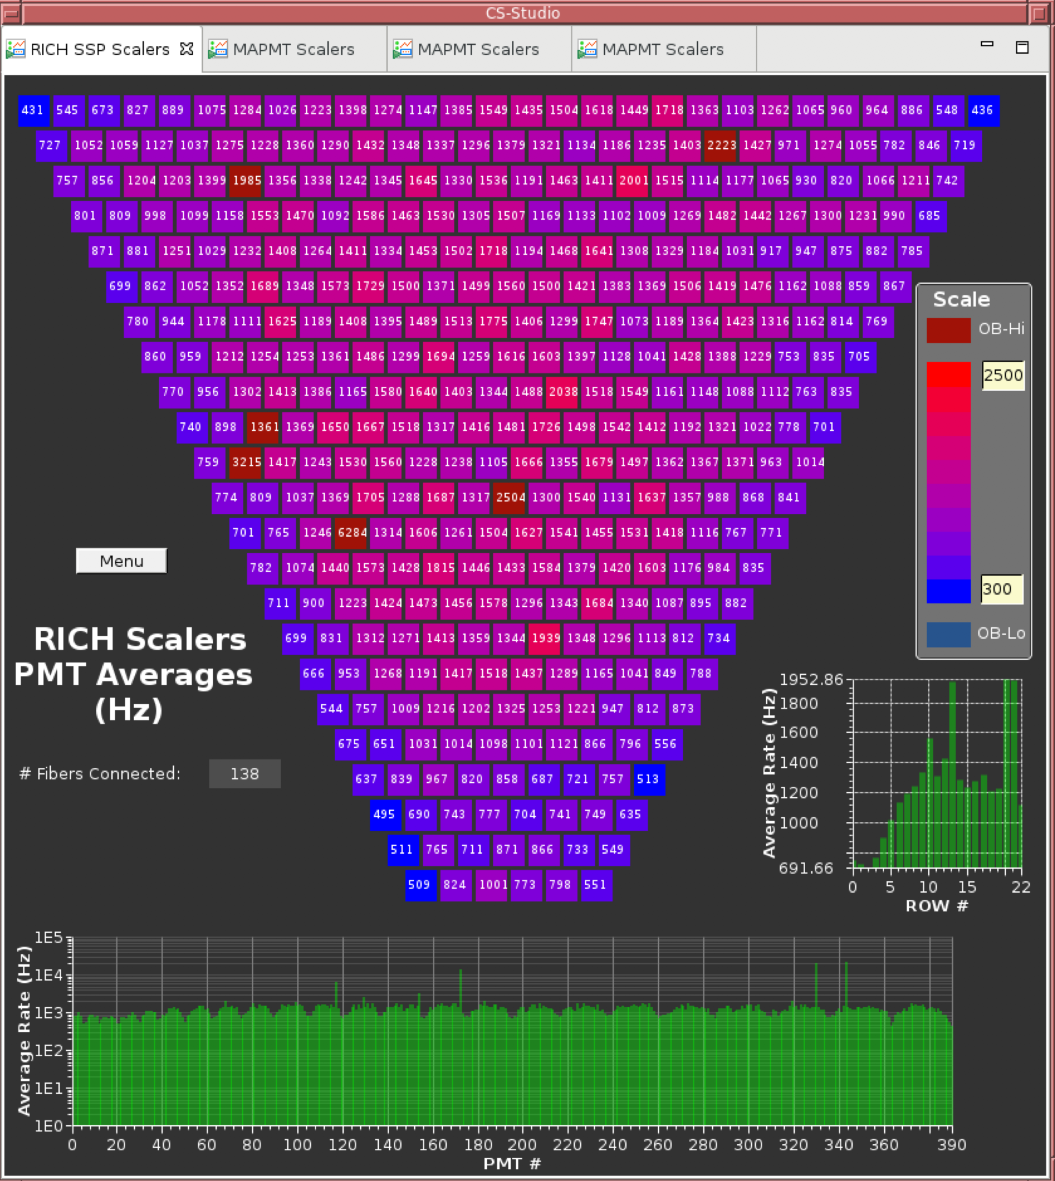
RICH scalers
The plot presents the
average rate of the MAPMT
pixels
ALL MAPMTs have to
be present

Slide 8
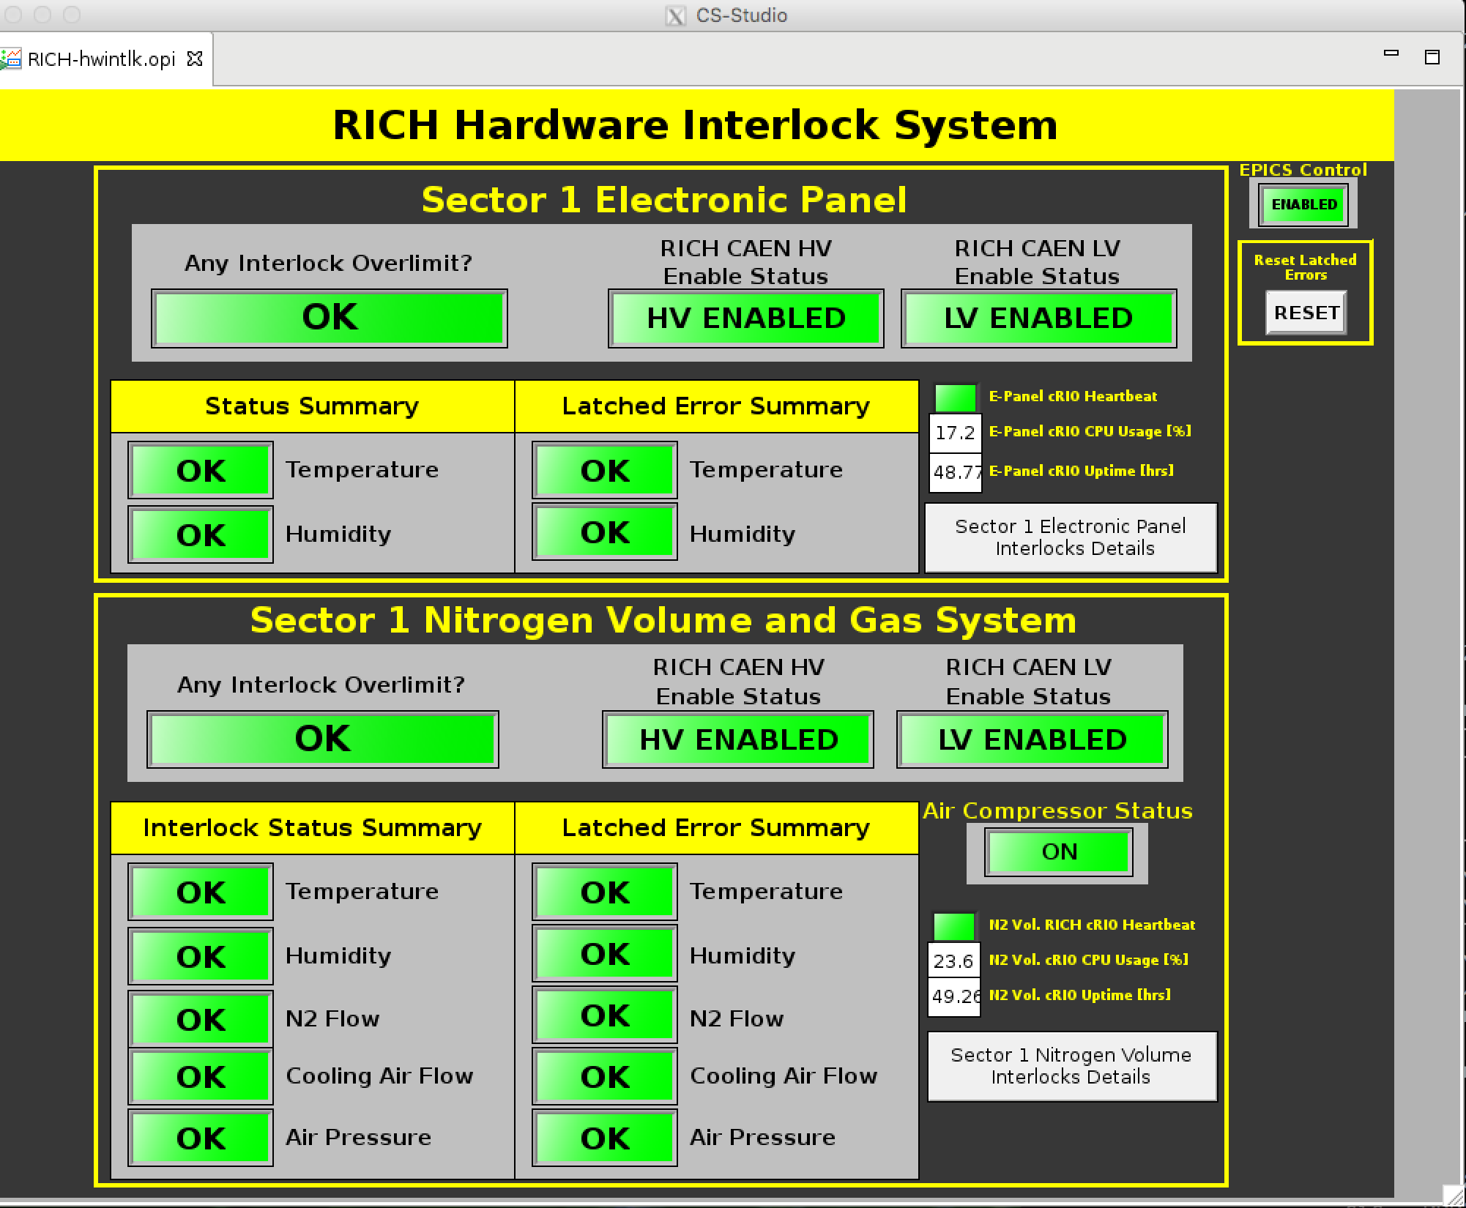
Hard Interlock
Hard Interlock
controls the
temperature
and humidity
inside the
RICH detector
Press this button
to view the
Electronic
panel Interlock
Press this button
to view the
Nitrogen volume
Interlock

Slide 9
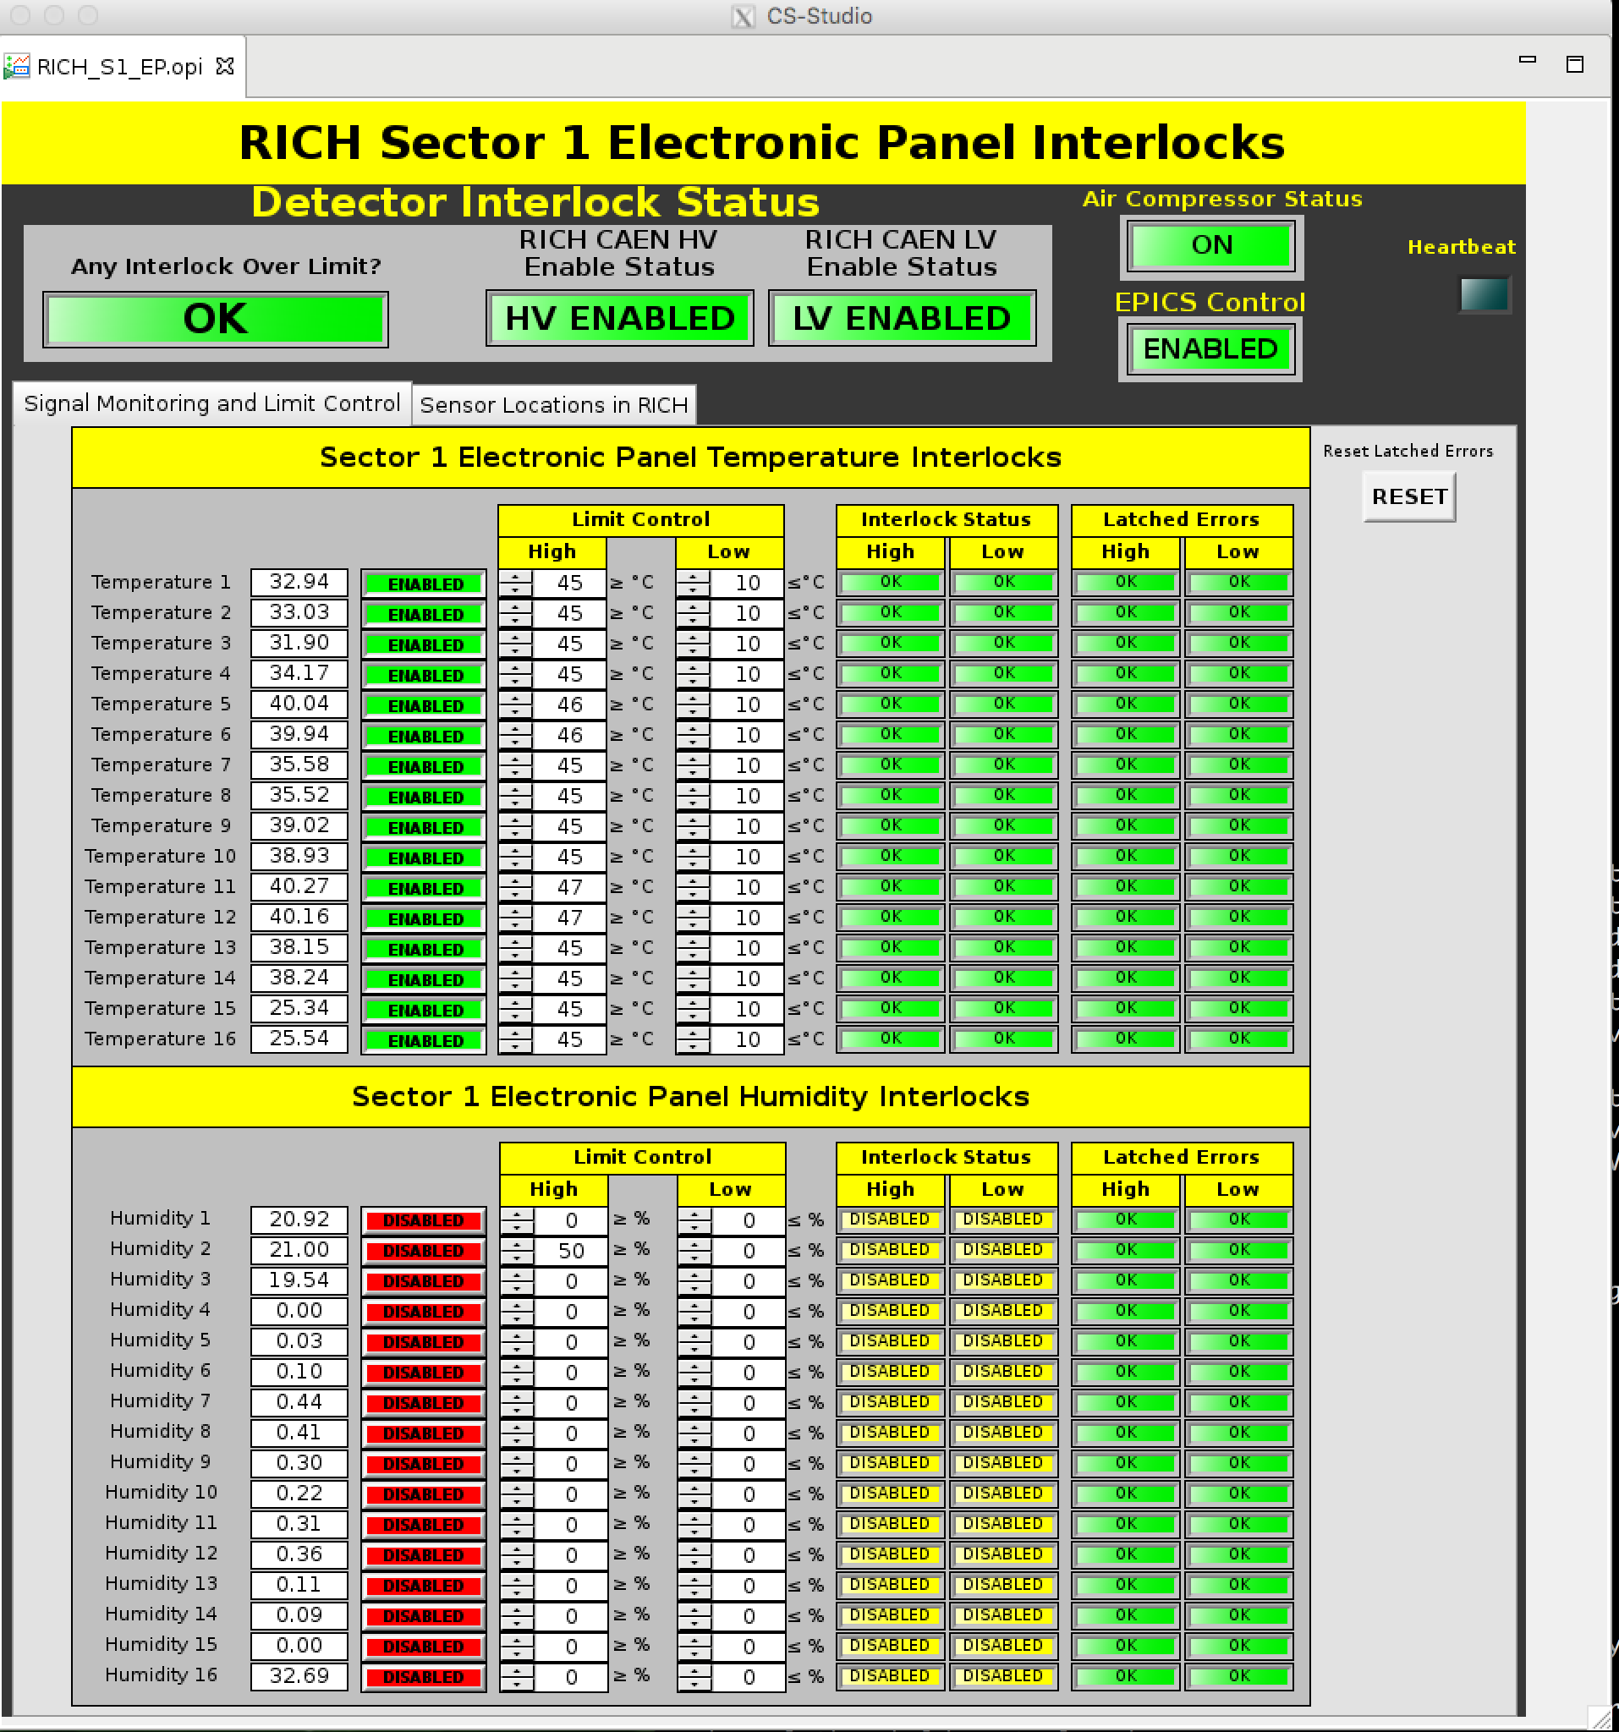
Electronic Panel Interlock
Check the temperature and humidity

Slide 10
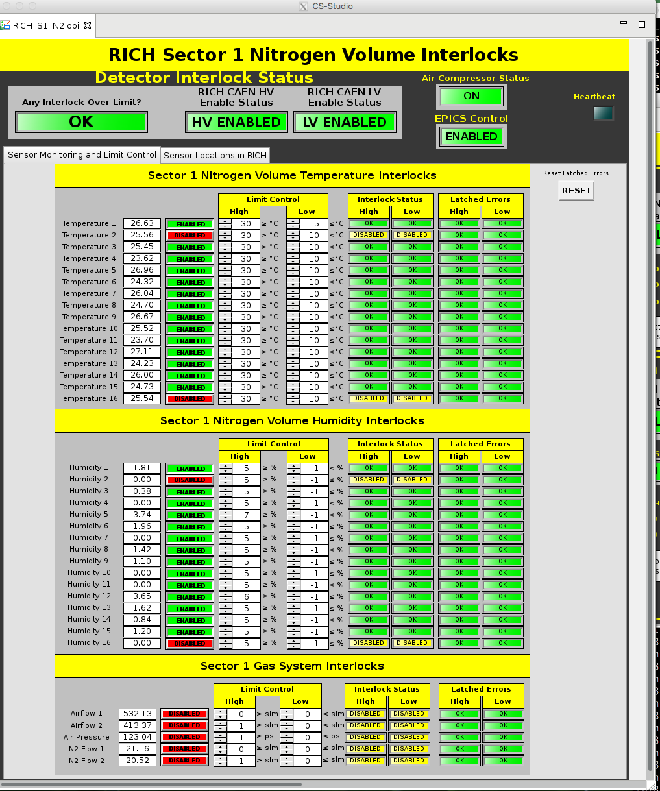
Nitrogen Interlock
Check the temperature and humidity

